Slide 1





Domain and Range
Technical terms for "input" and "output" of a function.
Domain - "input"
Range - "output"

Slide 2



Domain and Range
Words
Graphs
Equations
Table

Slide 3








Domain and Range
Words
Graphs
Equations
Table

Slide 4
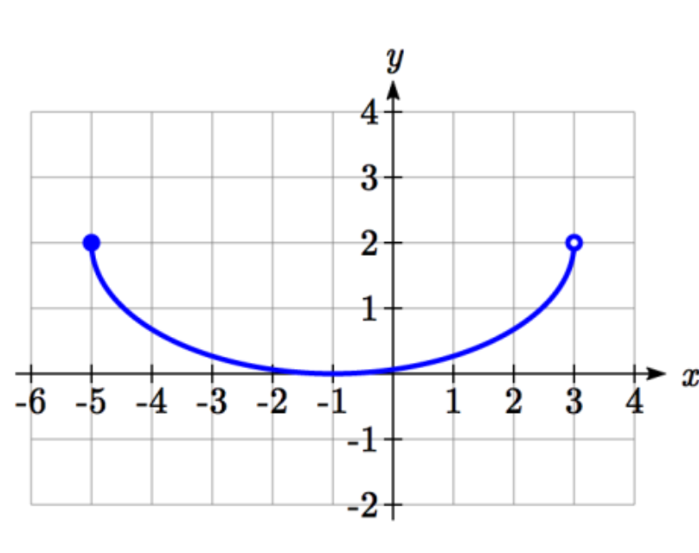


Domain and Range
Words
Graphs
Equations
Table

